Slide 1
Course : COMP8043041 – Machine Learning
Period : June 2023
Regression
Session 03
KDS – Amalia Zahra, S.Kom., Ph.D.

Slide 2
Learning Outcomes
After the completion of this session, students are expected to achieve the following learning outcomes:
LO2: Describe the characteristics of various Machine Learning algorithms and understand how each of them works, including the mathematical principles underlying the algorithms.
LO3: Apply relevant Machine Learning algorithms according to individual cases/problems and perform evaluation.
LO4: Analyze the results obtained from Machine Learning experiments from several perspectives.

Slide 3
Topics
Regression vs Classification
Regression Analysis
Simple Linear Regression
Non-linear Regression
Regression Model Evaluation

Slide 4
Regression vs Classification

Slide 5
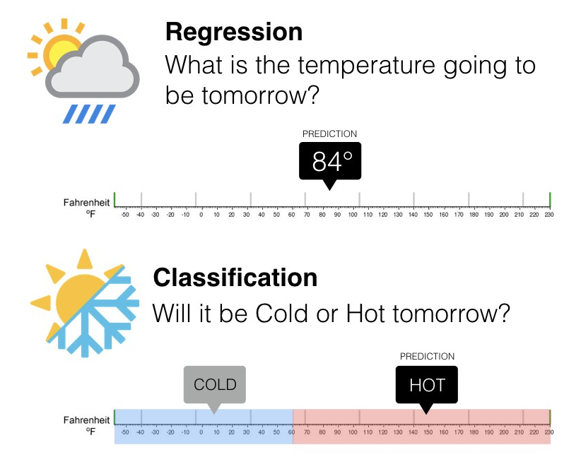
Regression vs Classification
predict numeric value (continuous)
predict category (discrete)
Regression and classification are both supervised learning.
Notes:
Source of image: https://medium.com/@ali_88273/regression-vs-classification-87c224350d69

Slide 6
Regression vs Classification: Algorithms
Regression | Classification
Linear Regression | k-Nearest Neighbor (KNN)
Non-Linear Regression | Decision Tree
Random Forest | Naïve Bayes
Multilayer Perceptron | Support Vector Machine (SVM)
Convolutional Neural Network (CNN) | Convolutional Neural Network (CNN)
etc | etc

Slide 7
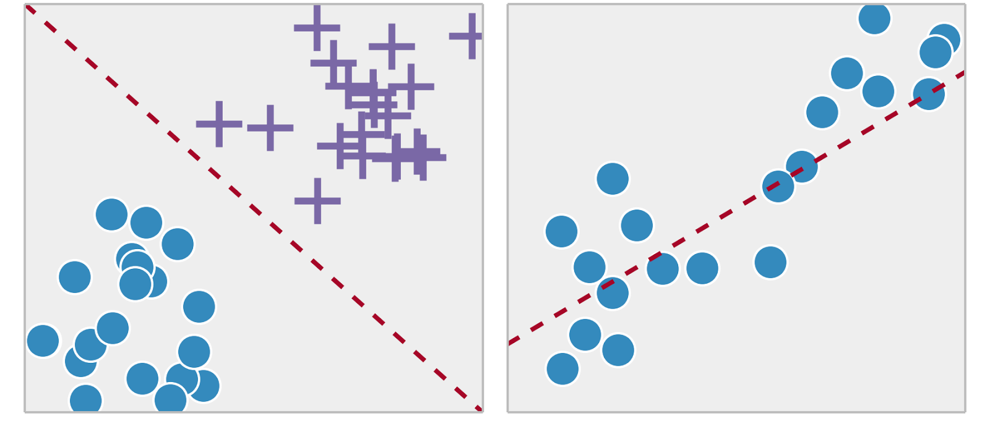
Quiz
Given the illustration below, which one is regression, and which one is classification?
(a)
(b)
Notes:
Source of image: https://towardsdatascience.com/supervised-vs-unsupervised-learning-14f68e32ea8d

Slide 8
Regression Analysis

Slide 9
What is Regression?
Regression analysis is a study that allows us to predict a continuous outcome variable/explained variable/dependent variable (y) based on the value of one or multiple predictor variable(s)/explanatory variable(s)/independent variable(s) (x).
If there is only one independent variable, the regression analysis is called simple regression.
simple linear regression and non-linear regression
If the number of independent variables is more than one, it is called multiple regression.
The outcome of regression analysis is an equation.
This equation is a function that receives value(s) of independent variable(s) to produce/predict a value of the dependent variable.

Slide 10
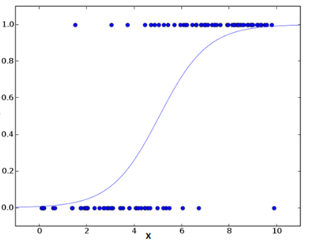

Logistic Regression
Logistic Regression is NOT used for regression!
Widely used for classification (dependent variable f(x) is binary).
All data must be in numeric.
Often used in neural network to introduce nonlinearity.
Data modeled to fit a logistic line (S-like shape).
Parameters k is estimated to "best fit" the data.

Slide 11
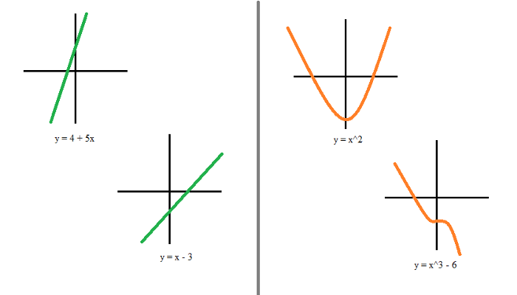
Regression
Regression Analysis
Linear Regression
Nonlinear Regression
Simple Linear Regression (SLR)
Multiple Linear Regression (SLR)
Quadratic Regression
Cubic Regression
straight line
curved line

Slide 12
Simple Linear Regression (SLR)
Regression Analysis

Slide 13
Simple Linear Regression (SLR)
x: independent variable / explanatory variable / predictor variable
y: dependent variable / explained variable / outcome variable
The result equation: linear equation

Slide 14
Case Examples of SLR
Relationship between the working duration of a machine with the quality of products produced by the machine.
Relationship between the number of employees with the number of items being produced.
Relationship between room temperature in a factory with damaged items being produced.

Slide 15
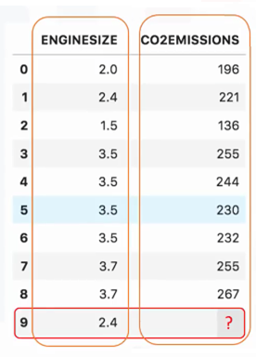
SLR Example
x: independent variable
y: dependent variable
Task: predicting CO2 emissions based on the engine size of a car.
x: engine size
y: CO2 emissions
new data sample

Slide 16
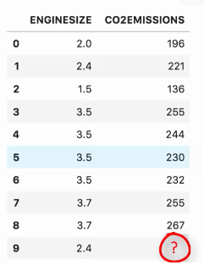
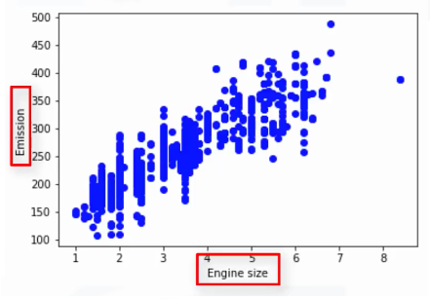
How SLR works
214
2.4
x = 2.4
y = 214
How to find this line?
Notes:
Pertanyaannya adalah: "Bagaimana Anda menggambar garis melalui poin sembarang data? "
Dan, "Bagaimana Anda menentukan fitted line terbaik'?"

Slide 17



Linear Regression Representation
: predicted emission
: engine size
: parameters
How to find the values for the two parameters ( )?
Notes:
θ1 dikenal sebagai "kemiringan" atau "gradien" dari fitted line; dan θ0 dikenal sebagai "intercept“.
θ0 dan θ1 juga disebut koefisien persamaan linear.

Slide 18
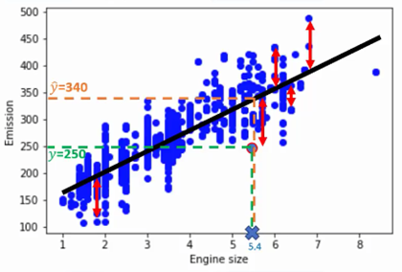
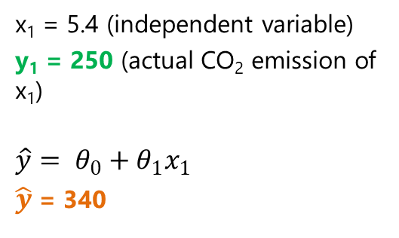
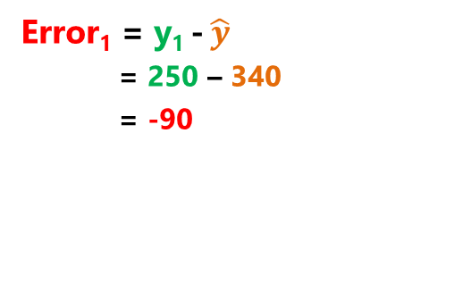
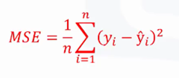
How to Find Fitted Line?
MSE: Mean Squared Error

Slide 19


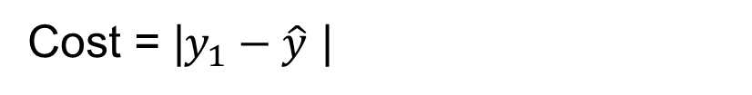
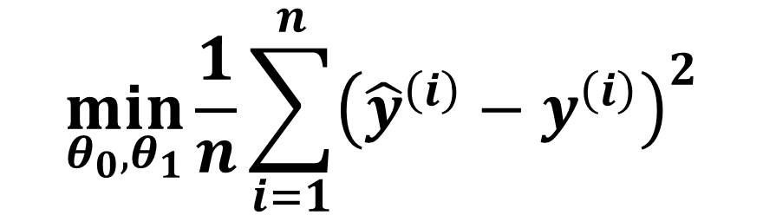

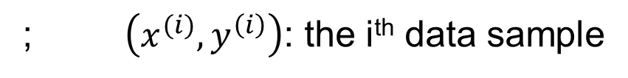
Cost Function
Actual data sample:
Predicted line :
Cost Function
Goal:
n: number of (training) data samples

Slide 20
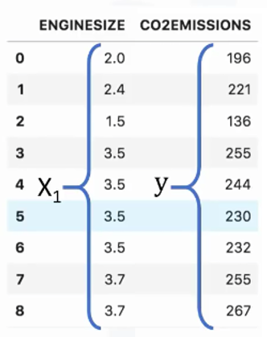
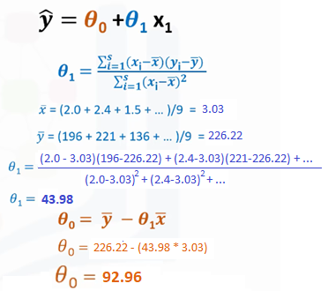

Parameters Estimation

Slide 21
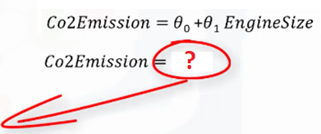
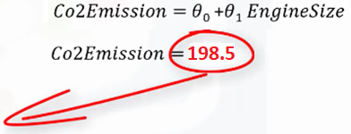
Prediction

Slide 22
Multicollinearity
Multicollinearity is a statistical concept where several independent variables in a model are correlated.
Two variables are considered perfectly collinear if their correlation coefficient is +/- 1.0.
Multicollinearity among independent variables will result in less reliable statistical inferences.

Slide 23
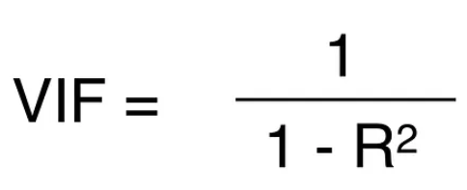
Multicollinearity (cont.)
One method to detect multicollinearity is to calculate the variance inflation factor (VIF) for each independent variable.
A VIF value of 1 means not correlated at all, in the interval of 1 to 5 means slightly inflated by multicollinearity, and above 5 is highly inflated.

Slide 24
NonLINEAR Regression
Regression Analysis

Slide 25
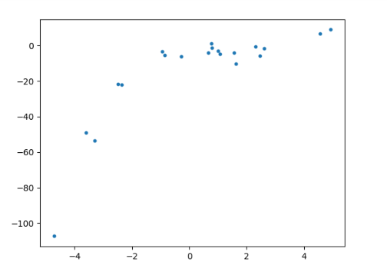
Why Nonlinear Regression?
Given the following data:
Should we use linear or nonlinear regression?

Slide 26
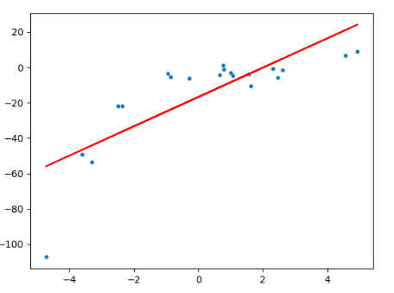
Why Nonlinear Regression? (Cont.)
Use linear model (degree 1):
Root Mean Squared Error (RMSE) of linear regression is 15.91.
R² score of linear regression is 0.64.
R² or R-squared (coefficient of determination): how close the data are to the fitted regression line.
Many data points are “far” from the line.
Condition: under-fitting
Notes:
R-squared = Explained variation / Total variation
R-squared is always between 0 and 100%:
0% indicates that the model explains none of the variability of the response data around its mean.
100% indicates that the model explains all the variability of the response data around its mean.

Slide 27
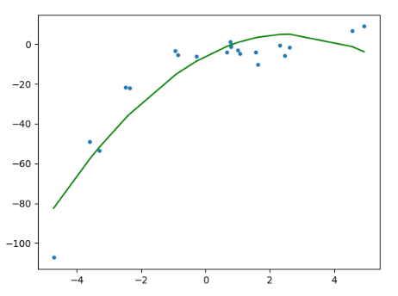
Why Nonlinear Regression? (Cont.)
Use nonlinear/quadratic model (degree 2):
RMSE of polynomial regression is 10.12.
R² score of polynomial regression is 0.85.
The line model is closer to the data distribution.

Slide 28
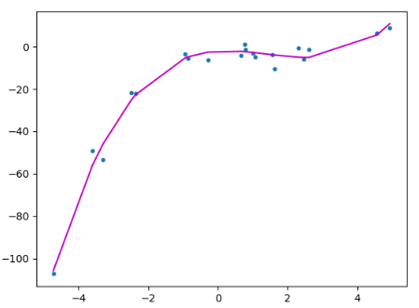
Why Nonlinear Regression? (Cont.)
Use nonlinear/cubic model (degree 3):
RMSE of cubic regression is 3.45.
R² score of cubic regression is 0.98.
The line model is even much closer to the data distribution.
Condition: appropriate-fitting / correct-fit

Slide 29
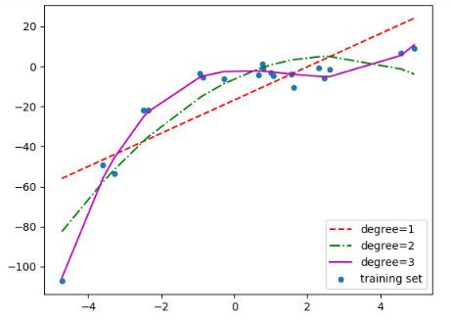
Comparison of 3 Models
Comparison between linear, quadratic, and cubic model:

Slide 30
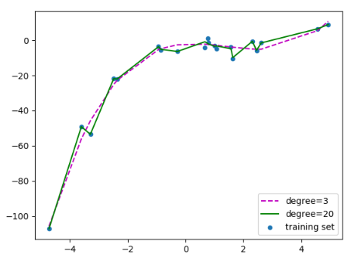
How about other degree?
Let’s say using degree 20:
The line model also goes through “noise” data.
Condition: over-fitting

Slide 31
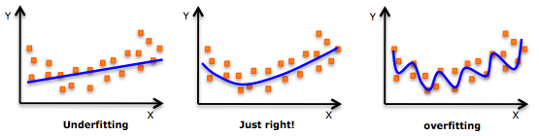
Underfitting vs Overfitting
Notes:
Source of image: https://www.analyticsvidhya.com/blog/2015/08/comprehensive-guide-regression/

Slide 32
Bias vs Variance
Bias
Bias refers to an error from erroneous assumptions in a learning algorithm.
High bias can cause an algorithm to miss the relevant relations between features and target outputs (underfitting).
Variance
Variance refers to an error from sensitivity to small fluctuations in the training set.
High variance can cause an algorithm to model the random noise in the training data, rather than the intended outputs (overfitting).
Notes:
Bias merujuk pada kesalahan, karena asumsi model yang sederhana dalam menyesuaikan data.
Bias yang tinggi artinya bahwa, model tidak dapat menangkap pola di dalam data dan ini mengakibatkan kondisi under-fitting.
Varians mengacu pada kesalahan, karena model yang kompleks mencoba menyesuaikan data.
Varians tinggi artinya model melewati sebagian besar titik pada data dan menghasilkan kondisi over-fitting

Slide 33
Non-Linear Regression Models
Some popular nonlinear regression models:
1. Exponential model:
2. Power model:
3. Saturation growth model:
4. Polynomial model:

Slide 34
Non-Linear Regression
Given n data points
best fit
to the data, where
is a nonlinear function of
.
Figure. Nonlinear regression model for discrete y vs. x data

Slide 35
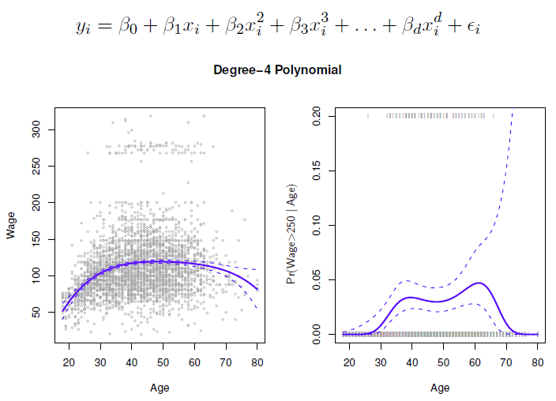
Example: Polynomial Regression
Notes:
Source of image: https://canvas.northwestern.edu/courses/20123/files/893282/download?verifier=sxgW4YH9PbvhDSDaEvmjkJKuAY9dgRxM6kqKTgkG&wrap=1

Slide 36
Regression Model Evaluation

Slide 37
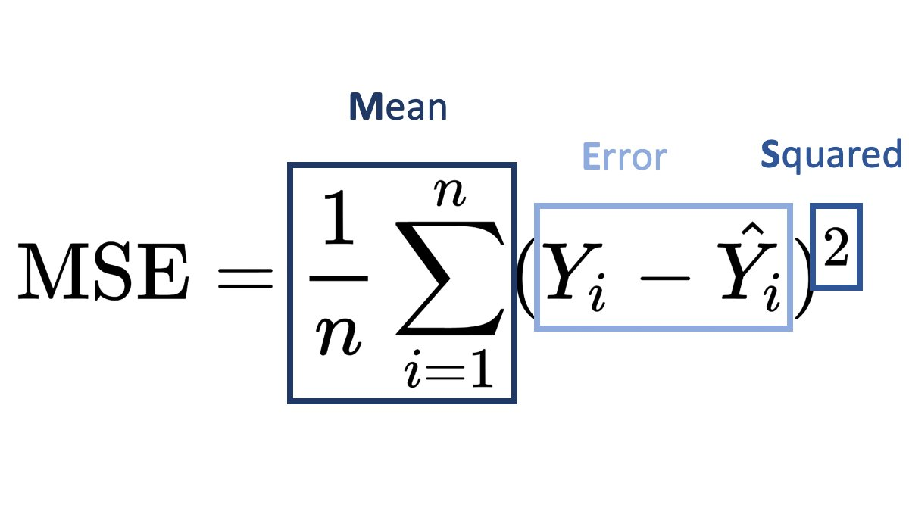
Mean Squared Error (MSE)

Slide 38
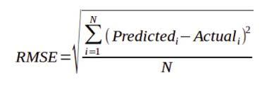
Root Mean Squared Error (RMSE)

Slide 39
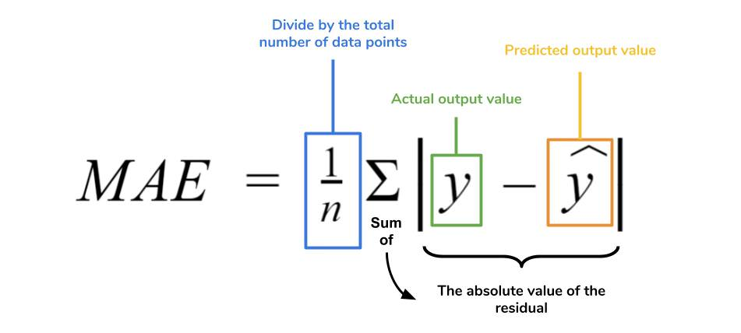
Mean Absolute Error (MAE)

Slide 40
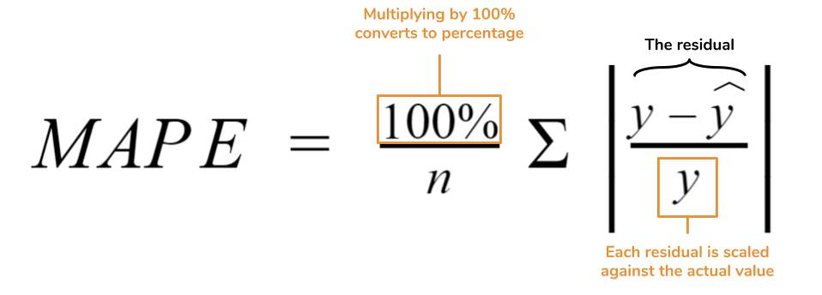
Mean Absolute Percentage Error (MAPE)

Slide 41
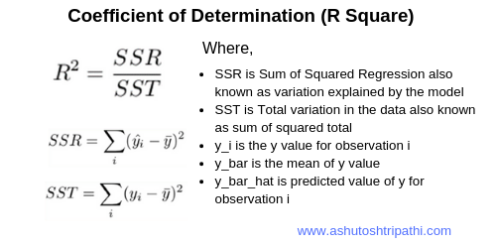
Coefficient of Determination (R²)

Slide 42
References
Bishop, C. M. (2006). Pattern recognition and machine learning. springer.
Mitchell, Tom M. (1997). Machine learning. McGraw Hill.
Flach, P. (2012). Machine learning: the art and science of algorithms that make sense of data. Cambridge University Press.
Harrington, P. (2012). Machine learning in action. Manning Publications Co..

Slide 43
Q&A

Slide 44
Thank You

